Slide 1

WallStreetBets
Subreddit
Keith Gill: $79,000,000
In a single day
led to a US Government
Investigation
adapted into a Netflix Documentary &
Major Motion Picture
WALLSTREETBETS
A sentiment analysis
Notes:
Hello: I will be presenting my sentiment analysis project of the WallStreetBets subreddit, which I may also refer to as WSB.
WSB, is a popular, and somewhat infamous, sub-reddit with a hobbyist community focused on the stock market.

Slide 2
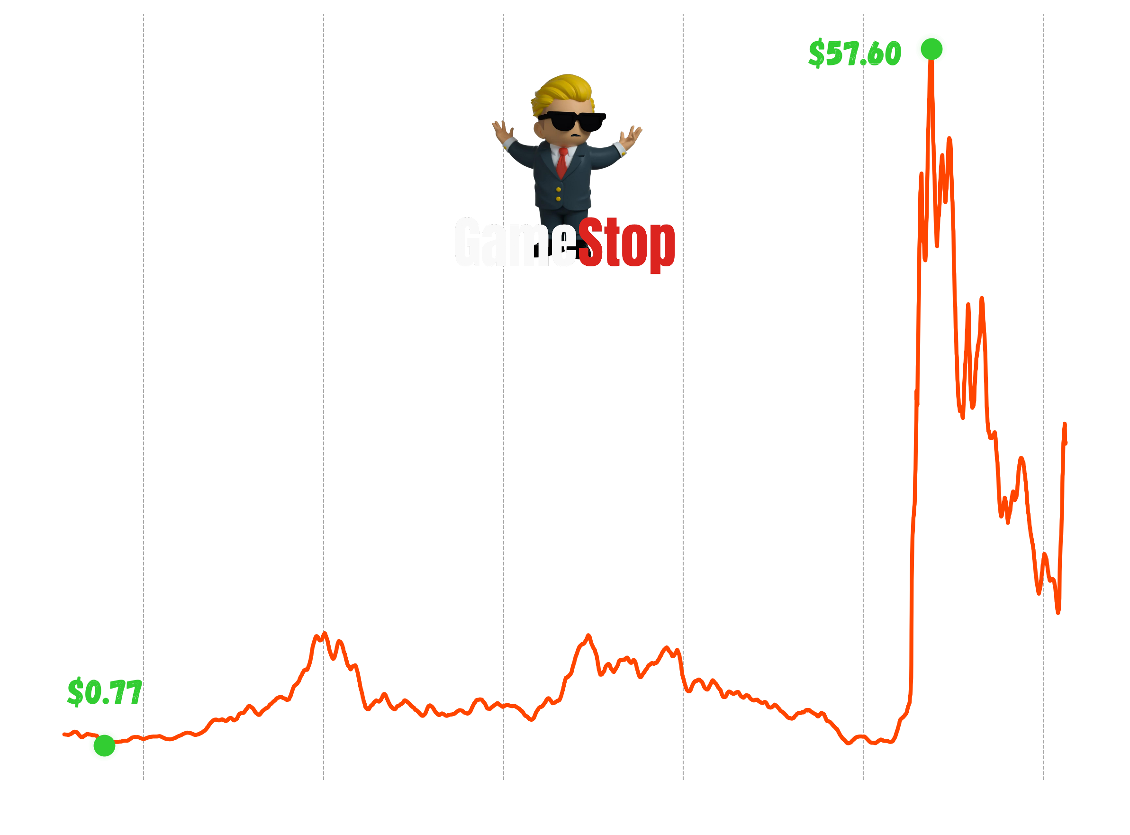
WallStreetBets
Subreddit
Keith Gill: $79,000,000
In a single day
led to a US Government
Investigation
adapted into a Netflix Documentary &
Major Motion Picture
WALLSTREETBETS
A sentiment analysis
Notes:
Speaker notes:
In 2020, events in this subreddit led to:
One man gaining $79,000,000 in a single day(1)
A congressional investigation by the US House Financial Committee.
Adaptation into a Netflix documentary and blockbuster film releasing this year.
Information Sources:
1 - Keith Gill Gain Value: https://investorplace.com/2024/06/how-much-did-keith-gill-make-from-gamestop-gme-stock-this-weeks-staggering-figures/#:~:text=This%20move%20comes%20as%20investors,gain%20of%20around%20%2479%20million.
2 – Keith Gill Gain Value again: https://www.cnbc.com/2024/06/04/how-roaring-kittys-wealth-went-from-53000-to-nearly-300-million-and-could-one-day-top-1-billion.html
Resources:
Time series plot: Harry Murphy and data analysis libraries in python
Background Image: Harry Murphy
Timeline of the GME short squeeze: https://www.thestreet.com/investing/stocks/a-timeline-of-the-gamestop-short-squeeze

Slide 3
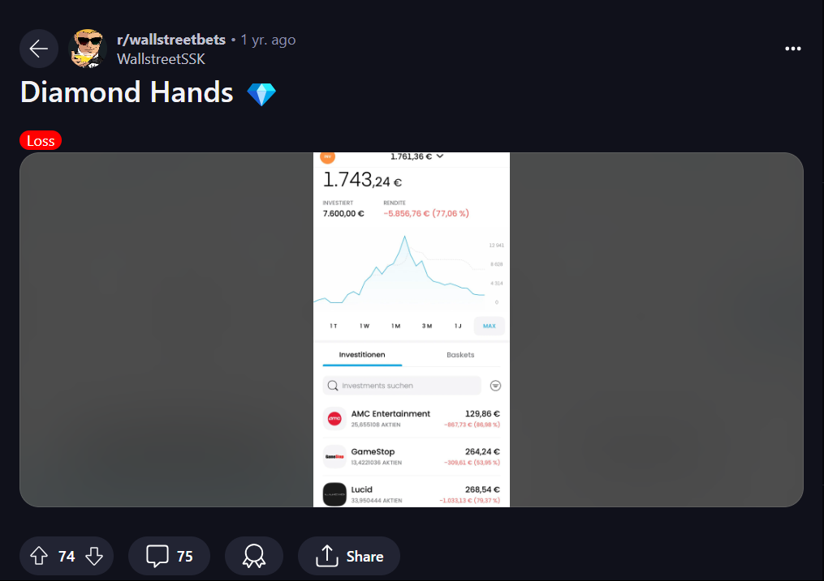
WallStreetBets
Subreddit
Keith Gill & the short squeeze
Keith Gill: $79,000,000
In a single day
led to a US Government
Investigation
adapted into a Netflix Documentary &
Major Motion Picture
WALLSTREETBETS
A sentiment analysis
YOLO Traders and Diamond Hands 💎
Notes:
Speaker notes:
The Gamestop Short Squeeze was an infamous financial event during which many retail traders, those not affiliated with financial institutions, made lifechanging returns on their investment to the gamestock or GME stock.
Whilst hedge funds and traditional traders lost roughly $838 million in a single day.
This was team effort, with wallstreetbets being a major player acting as a platform, organizing retail investors.
Enabling a large influx of investment increasing volatility in the company’s publicly traded stock.
Source:
2- Keith Gill: https://www.reuters.com/business/finance/who-is-keith-gill-online-influencer-sending-gamestop-shares-soaring-again-2024-06-07/
Personal Notes:
- Volatility: how often and by how much something changes over time.
Sources:
1 – Average stock volatility: https://www.fosterandmotley.com/insights/2019/02/20/what-is-volatility-and-is-it-normal
Resources:
Wallstreet bets mascot: https://the-youtooz.fandom.com/wiki/WSB_Kid?file=WSB_Kid_Physical_Front.jpg
Sub-reddit post: https://www.reddit.com/user/WallstreetSSK/

Slide 4
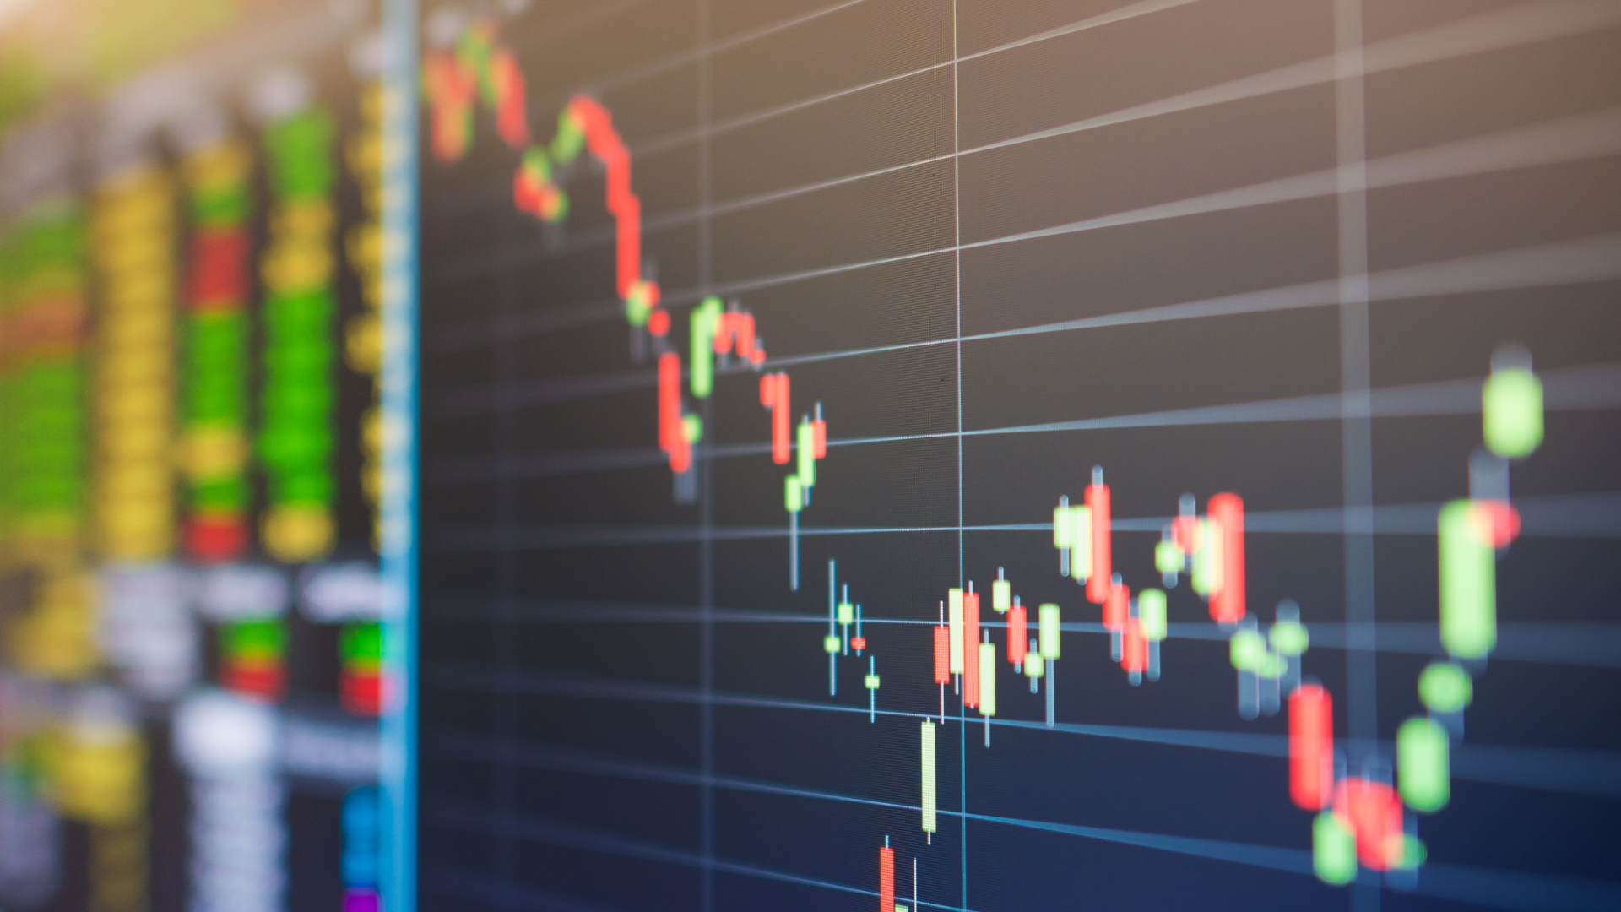
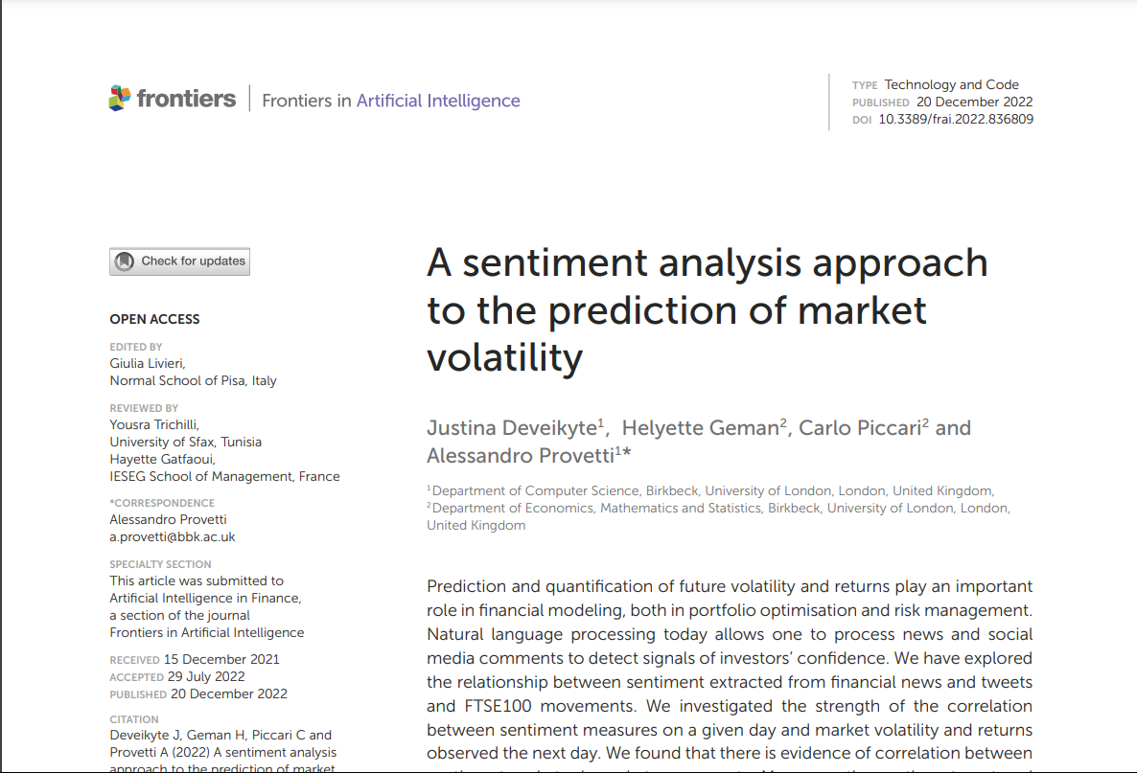
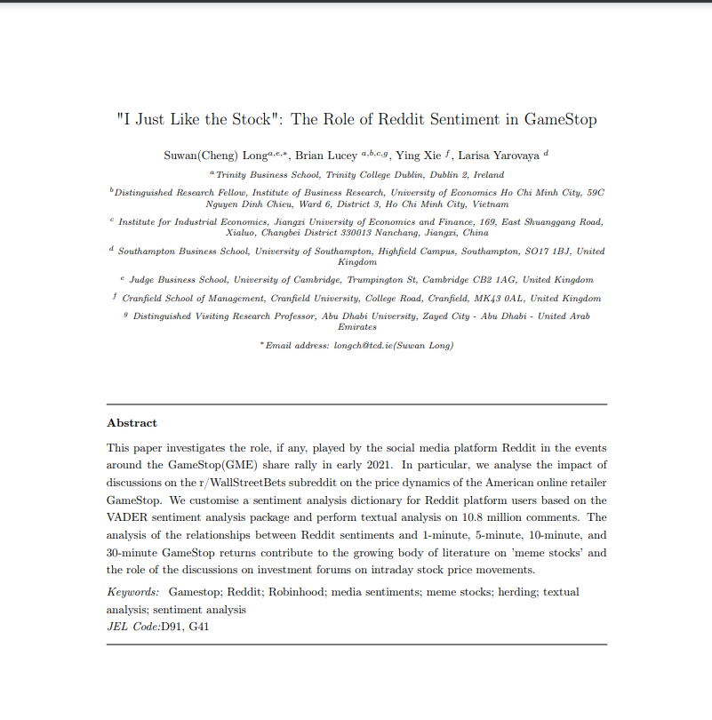


Keith Gill & the short squeeze
WallStreetBets
Subreddit
YOLO Traders and Diamond Hands 💎
Keith Gill: $79,000,000
In a single day
led to a US Government
Investigation
adapted into a Netflix Documentary &
Major Motion Picture
WALLSTREETBETS
A sentiment analysis
Social Media Sentiment & Stock Performance
Twitter sentiment and market volatility
WSB sentiment & GME returns
Notes:
Speaker notes:
Importantly, the community of members in WSB was likely integral to this success.
One term: “diamond hands” is an accurate representation of the people who made the GME short possible.
Many members of this sub-reddit take pride in not selling stocks they own despite market downturns.
They add diamond emojis to their posts – signifying they have diamond hands and are brave enough to wait for a big pay-off.
Interestingly, this leads to a dilemma in sentiment analysis of this sub-reddit:
Often negative sentiment, like expressing annoyance that a stock isn’t performing well, doesn’t necessarily reflect poorly on the stock.
There are many posts with a seemingly bad sentiment towards a stock that are followed by rocket and diamond emojis: symbolizing a prediction towards a successful future for the stock: i.e. a positive sentiment.
I will address how I tackled this problem later.
Personal Notes:
- Volatility: how often and by how much something changes over time.
Sources:
1 – Average stock volatility: https://www.fosterandmotley.com/insights/2019/02/20/what-is-volatility-and-is-it-normal
Resources:
Wallstreet bets mascot: https://the-youtooz.fandom.com/wiki/WSB_Kid?file=WSB_Kid_Physical_Front.jpg
Sub-reddit post: https://www.reddit.com/user/WallstreetSSK/

Slide 5
Keith Gill & the short squeeze
WallStreetBets
Subreddit
YOLO Traders and Diamond Hands 💎
Keith Gill: $79,000,000
In a single day
led to a US Government
Investigation
adapted into a Netflix Documentary &
Major Motion Picture
WALLSTREETBETS
A sentiment analysis
Social Media Sentiment & Stock Performance
Twitter sentiment and market volatility
WSB sentiment & GME returns
Notes:
So… is there any validity to monitoring social media sentiment for stock performance?

Slide 6
Keith Gill & the short squeeze
WallStreetBets
Subreddit
YOLO Traders and Diamond Hands 💎
Keith Gill: $79,000,000
In a single day
led to a US Government
Investigation
adapted into a Netflix Documentary &
Major Motion Picture
WALLSTREETBETS
A sentiment analysis
Social Media Sentiment & Stock Performance
Twitter sentiment and market volatility
WSB sentiment & GME returns
Notes:
​Justina Deveikyte and colleagues found social media sentiment was strongly negatively correlated with next day market volatility.(1)

Slide 7


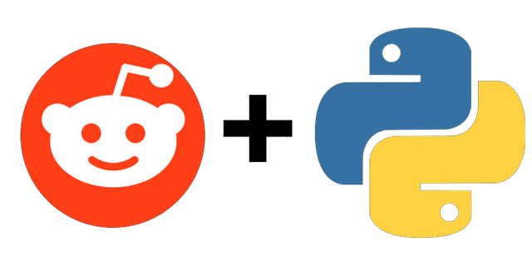

Keith Gill & the short squeeze
WallStreetBets
Subreddit
YOLO Traders and Diamond Hands 💎
Keith Gill: $79,000,000
In a single day
led to a US Government
Investigation
adapted into a Netflix Documentary &
Major Motion Picture
WALLSTREETBETS
A sentiment analysis
Social Media Sentiment & Stock Performance
Twitter sentiment and market volatility
WSB sentiment & GME returns
PRAW
VADER
DATA ANALYSIS
LIBRARYS
Notes:
Suwan Long and colleagues found across 30 minute intervals the net sentiment in the wallstreetbets subreddit significantly impacted the GME stock returns. (3)
Where does this project fit in?
Whilst peer review research on this topic is novel, there is clearly potential for sentiment analyses of the WSB sub-reddit to aid stock price prediction.
Similar projects to this one do exist, however, from personal research none reported a strong correlation between sentiment and stocks outside of a single trading bot (4).
Furthermore, Suwan Long’s team incorporated a custom lexicon, bespoke to the WSB sub-reddit. Other similar projects often use more general sentiment analysis libraries, likely limiting them.
This project was an attempt to combine the work of these academic papers and apply them to current data, leading to actionable insights of the stock market.
Sources:
1 – Academic article found strong correlation between social media sentiment and volatility: https://www.frontiersin.org/journals/artificial-intelligence/articles/10.3389/frai.2022.836809/full
2 – Similar project outlines need for further research and limited causality, contradictory to 1: https://www.reddit.com/r/wallstreetbets/comments/wrlg86/i_did_sentiment_analysis_on_reddityes_that/
3 – Academic Paper Quantifying sentiment relationship with GME stock returns: https://eprints.soton.ac.uk/471991/1/Gamestop_Reddit_Sentiments_3_.pdf
4- The trading bot: https://www.reddit.com/r/Python/comments/nmdy7n/used_python_to_build_a_rwallstreetbets_sentiment/
- Uses VADER and introduces a custom lexicon

Slide 8
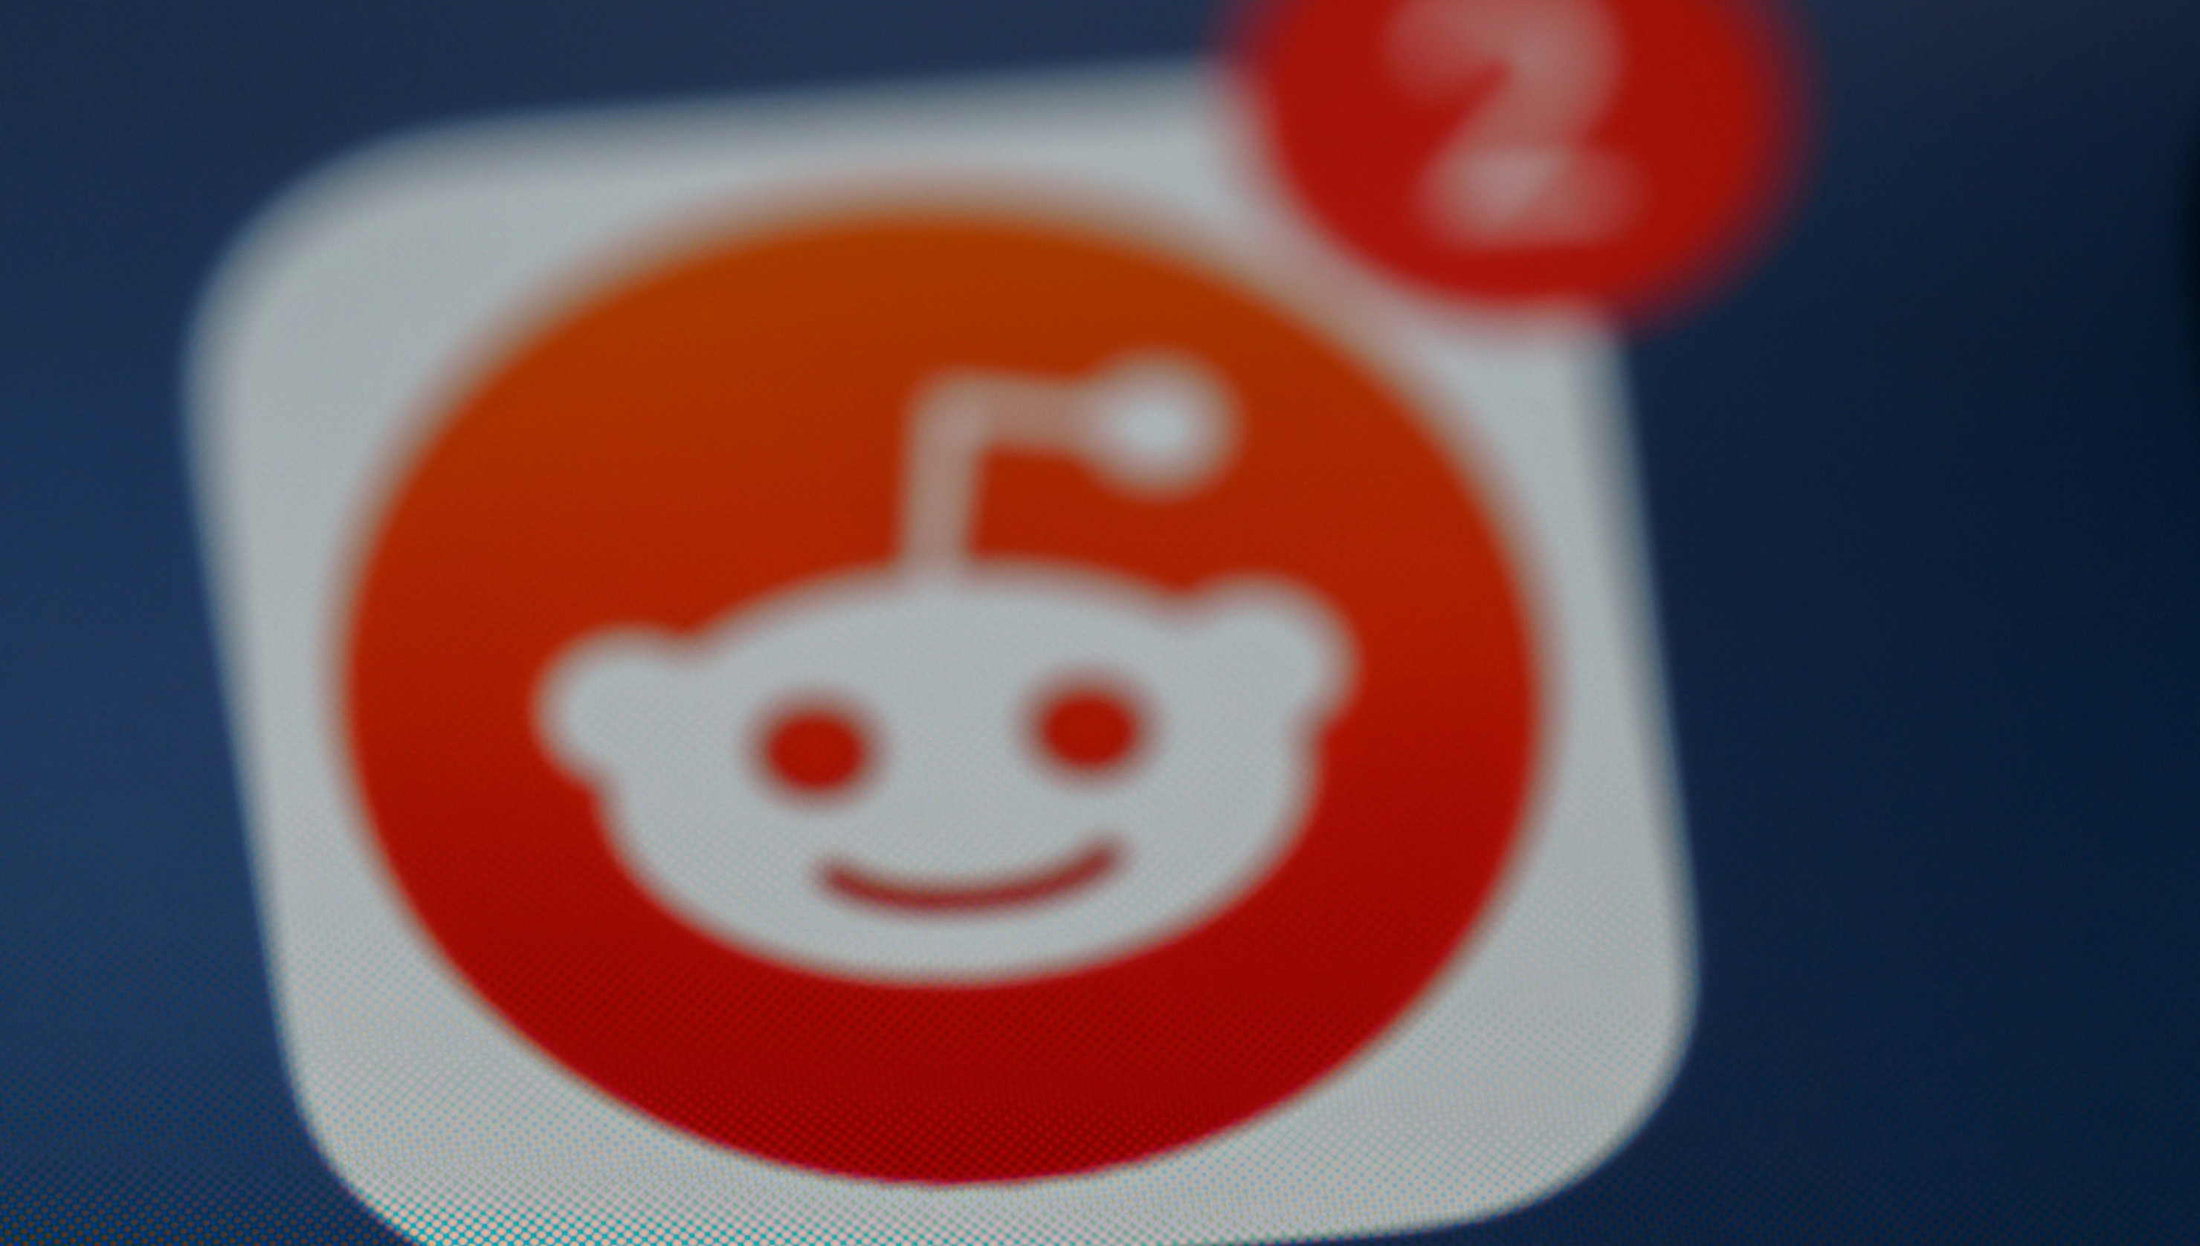
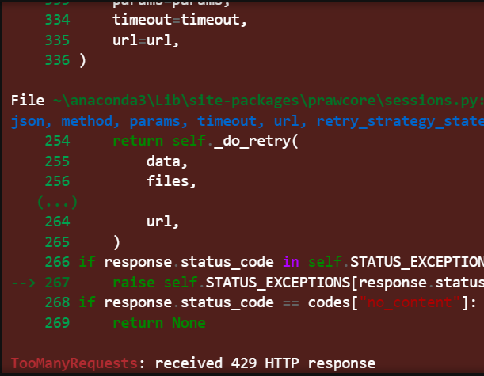
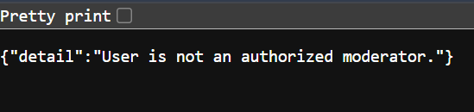
Twitter sentiment and market volatility
WSB sentiment & GME returns
PRAW
VADER
DATA ANALYSIS
LIBRARYS
Reddit Request Limit
PushShift Access Denial
Notes:
The Project: Data Collection
Firstly the tools:
PRAW, the Python Reddit API Wrapper was used to access posts and comments from the sub-reddit.
This had been used by others conducting similar analyses and provided easy to use classes and methods to enhance readability and reduce complexity when collecting data from a submission(a.k.a. post).
VADER, Valence Aware Dictionary and Sentiment Reasoner is a pre-trained natural language processing tool. Optimised for social media text data and provides functionality to create a custom lexicon for enhanced sentiment analysis in bespoke use cases.
The custom lexicon was integral to this project due to the previously highlighted quirks of how the WSB community communicates in posts.
Furthermore, this had been used by other successful stock market predictive projects involving twitter (1).
Other than this, standard data analysis python libraries were used throughout the project.
Sources:
1 – Academic article found strong correlation between social media sentiment and volatility: https://www.frontiersin.org/journals/artificial-intelligence/articles/10.3389/frai.2022.836809/full
2 – Similar project outlines need for further research and limited causality, contradictory to 1: https://www.reddit.com/r/wallstreetbets/comments/wrlg86/i_did_sentiment_analysis_on_reddityes_that/
3 – Academic Paper Quantifying sentiment relationship with GME stock returns: https://eprints.soton.ac.uk/471991/1/Gamestop_Reddit_Sentiments_3_.pdf
Resources:
Praw image: https://towardsdatascience.com/exploring-reddits-ask-me-anything-using-the-praw-api-wrapper-129cf64c5d65

Slide 9
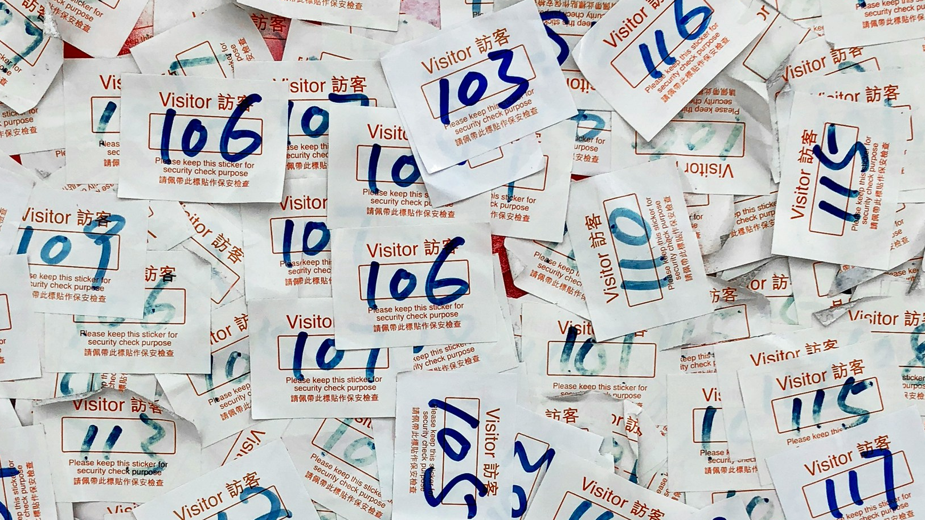
PRAW
VADER
DATA ANALYSIS
LIBRARYS
Labelling the data
Reddit Request Limit
PushShift Access Denial
50,000 data points
Limited funds
Generative AI labelling
Notes:
The Project: Data Collection
Limitation 1: Reddit API Restrictions
The initial goal of data collection was to gather 60,000 text-based posts or comments for a two-week period.
It appeared this would enable a robust training dataset for the sentiment analysis model.
And this was the same size of dataset used in other successful projects (1).
Soon into data collection I realised this was not feasible.
For a two-week period, the number of posts in the sub-reddit was around 1000, and even with 20 comments per post, I would only be able to collect a third of the observations.
Further on into the project it became clear the reddit API limited requests to the most recent 1000 posts, including comments.
I explored alternative options including using a higher functionality reddit API called PushShift.IO
This API has tools to combat throttling, contains a bank of historical reddit data, and data can be gathered per timeframe.
However, access to this API required moderator access and to achieve this was not feasible in the time frame of the project.
1000 of the most recent posts to the WSB sub-reddit were gathered and saved to a csv file, including timestamp, title, and body of text.
Importantly, the encoding used needed to be UTF-16 or higher or else emojis, a key determinant of sentiment, were not represented appropriately in the resulting data set. Author information, including usernames, was not collected using the API. Reducing the workload, by removing the need for anonymisation.
Still, this was not enough data to train and fit the model. So I sourced a historical WSB dataset from Kaggle, containing 50,000 unlabelled observations.

Slide 10
Labelling the data
Reddit Request Limit
PushShift Access Denial
50,000 data points
Limited funds
Generative AI labelling
Notes:
The Project: Labelling the data
For training
Prior to building the model. The data required sentiment labels.
As this was a supervised learning task, in order to train the model and generate performance metrics the data needed to be labelled with accurate sentiment before being used in training.
My initial approach was to coach my mum on how to interpret sentiment in the sub-reddit and teach her the, sometimes offensive, community slang words. In 2 hours we had labelled 150 posts and my mum was wondering why I was doing it in the first place.
Upon further research I found there were paid services specifically for labelling language data for models.
Unable to afford these services, I read about a workaround using generative AI.
Some had reported it had the potential to perform better than human labelling (1)
Whilst experimenting with this it became clear that, as a large language model, ChatGPT did a solid job of knowing the meaning behind even niche references and slang terminology, specifically within the WSB sub-reddit.
Therefore, as a pre-trained model built to analyse social media I made the decision to omit the labelling and build the VADER model without fitting or performance metrics.
Whilst not ideal, the idea of using generative AI seemed more appropriate for generating a custom lexicon.
A text file with < 1000 entries would be easier to oversee than a dataset with 50,000 values.
Furthermore, the metrics generated from an AI labelled dataset would be limited to the unquantified capability of the AI.
Sources:
ChatGPT for labelling: https://www.linkedin.com/pulse/chatgpt-outperforms-humans-labelling-some-data-other-ais-sayeed/
Labelling services: https://info.cloudfactory.com/data-labeling?utm_medium=ppc&utm_source=adwords&utm_term=data%20annotation%20service%20providers&utm_campaign=C_Core_DL_DLA_CC_EG_1&hsa_mt=e&hsa_cam=20462804612&hsa_tgt=kwd-1602036803471&hsa_acc=5324129487&hsa_grp=153240738915&hsa_src=g&hsa_net=adwords&hsa_ad=670054382118&hsa_ver=3&hsa_kw=data%20annotation%20service%20providers&gad_source=1&gclid=CjwKCAjwkJm0BhBxEiwAwT1AXH9HsblhzNkofLj9b0uP4Jcna90NY04uMiLq2ytUDU78DzUrTh1ZyhoCVaIQAvD_BwE

Slide 11
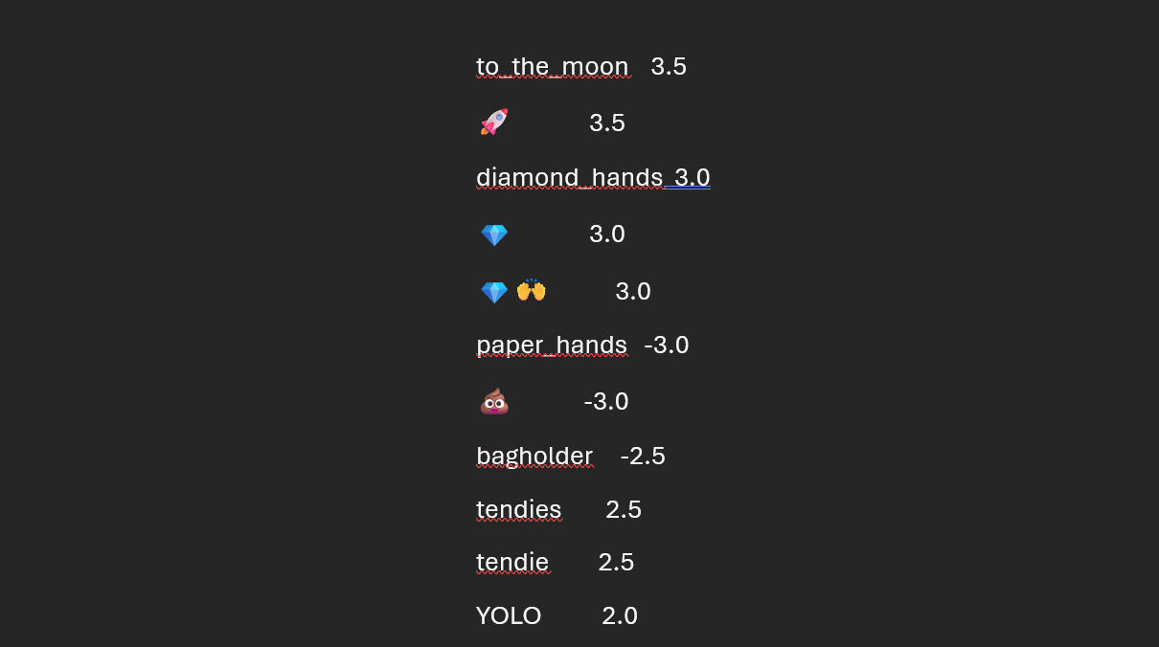
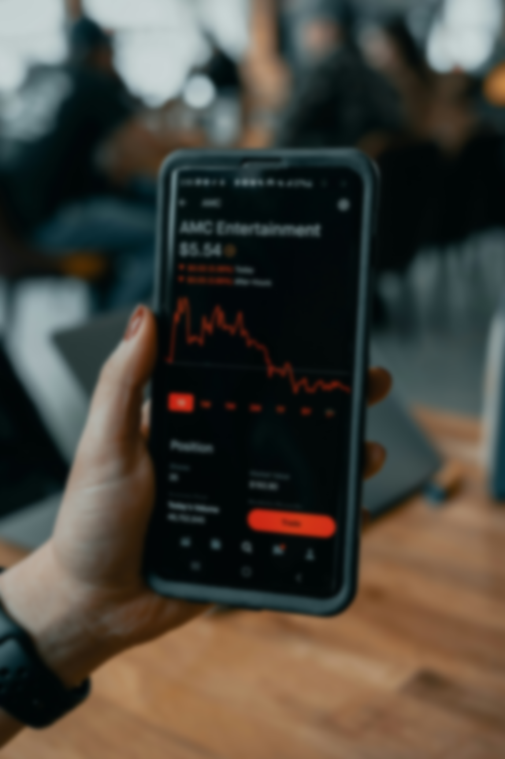
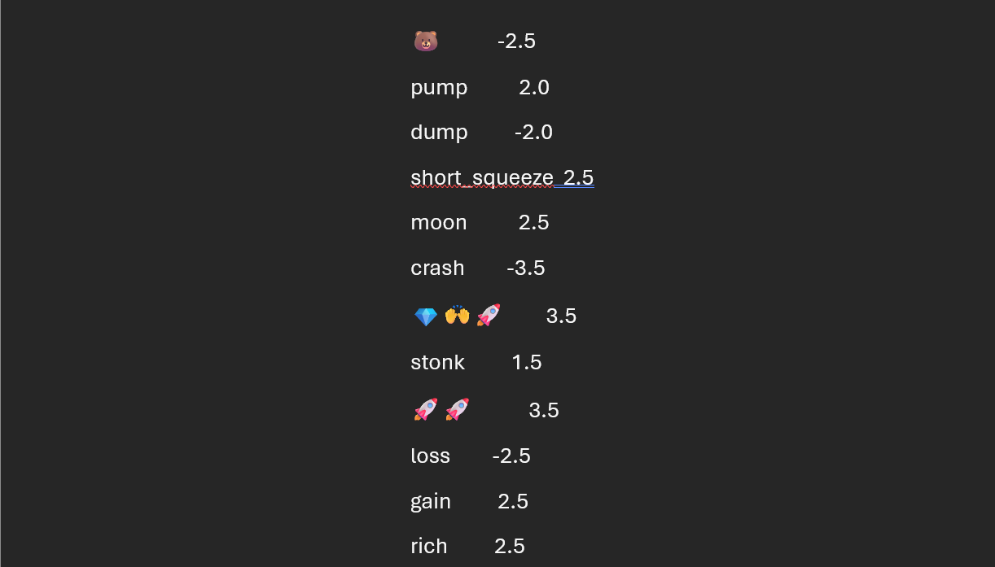
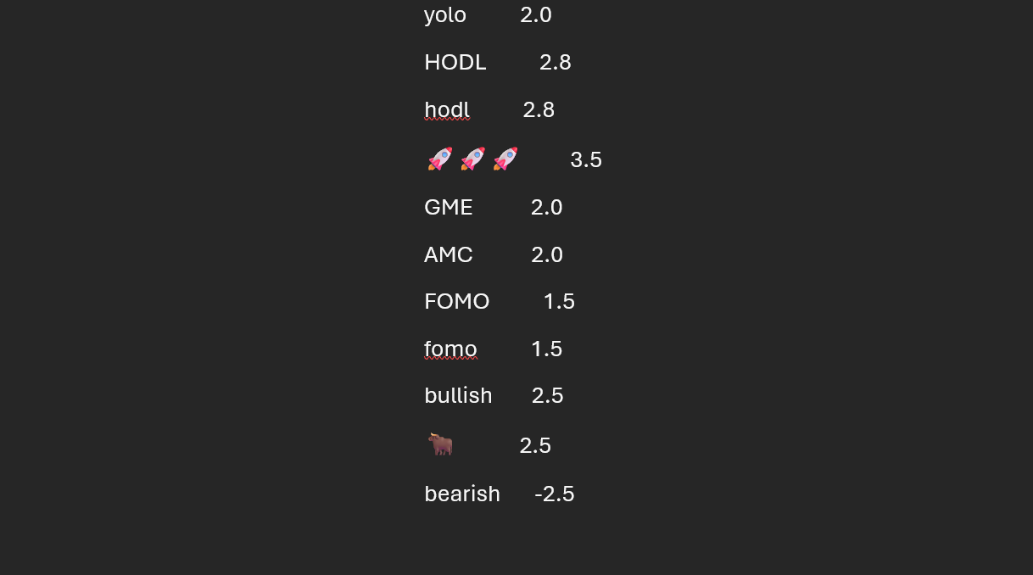
Generative AI
Custom Lexicon
Notes:
Generative AI and the custom lexicon:
So I chose instead to create a custom lexicon with every slang term ChatGPT could produce for WSB.
This yielded 99 unique terms and emoji combinations, each with a VADER sentiment score to be used by the model.

Slide 12
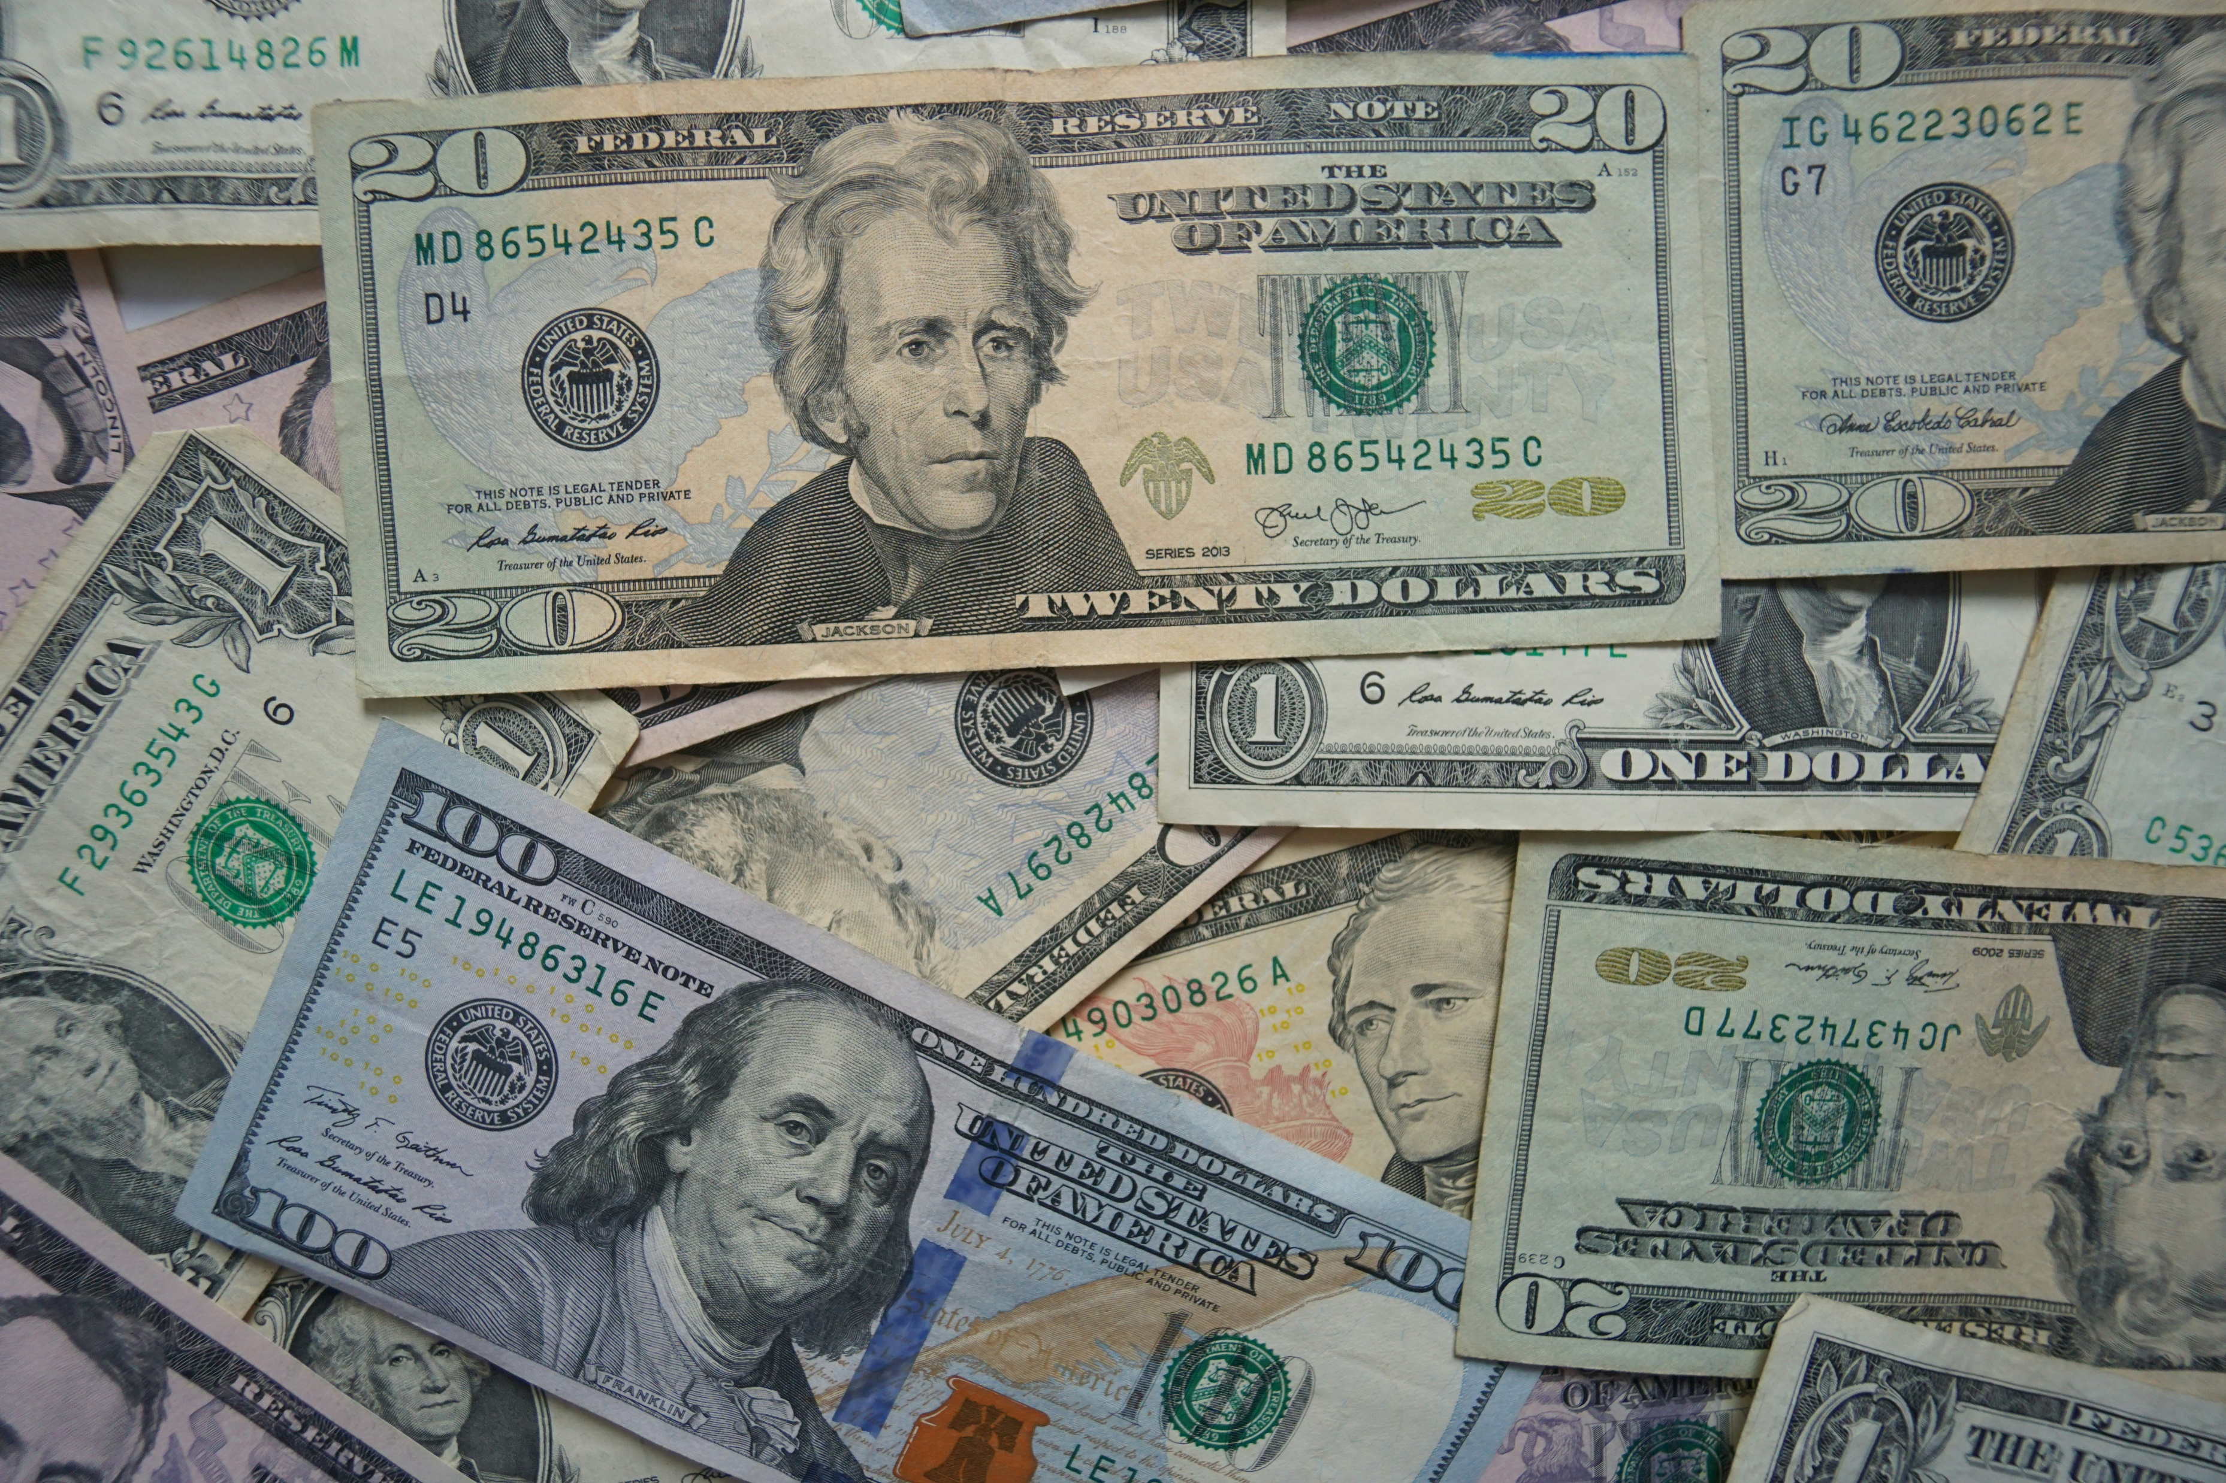

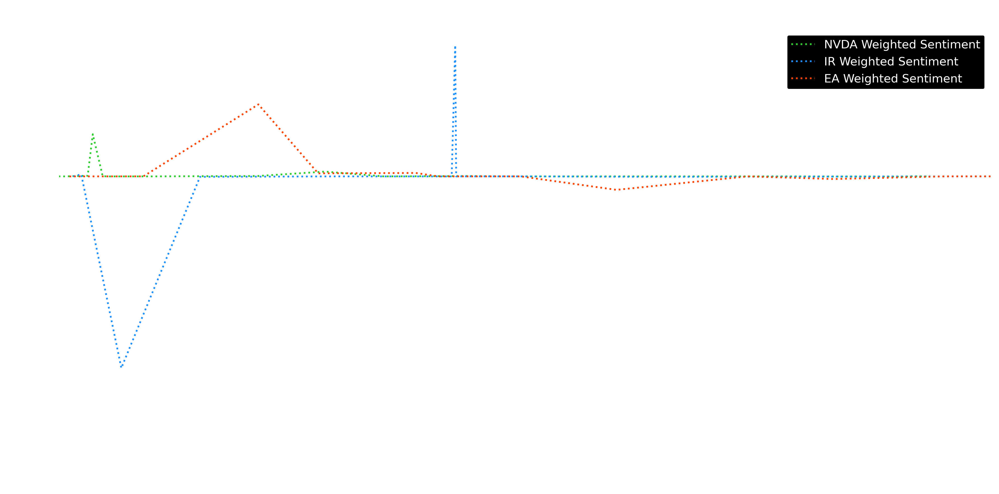
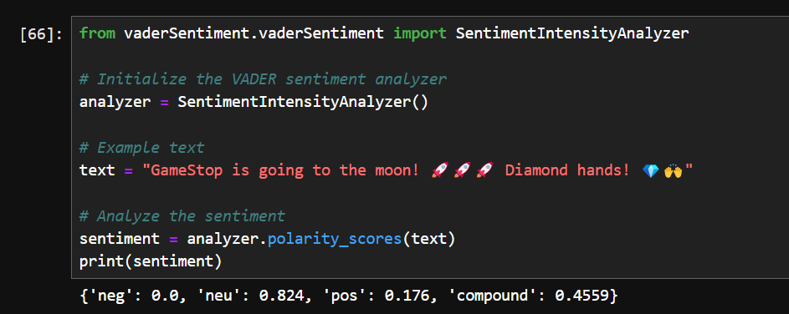
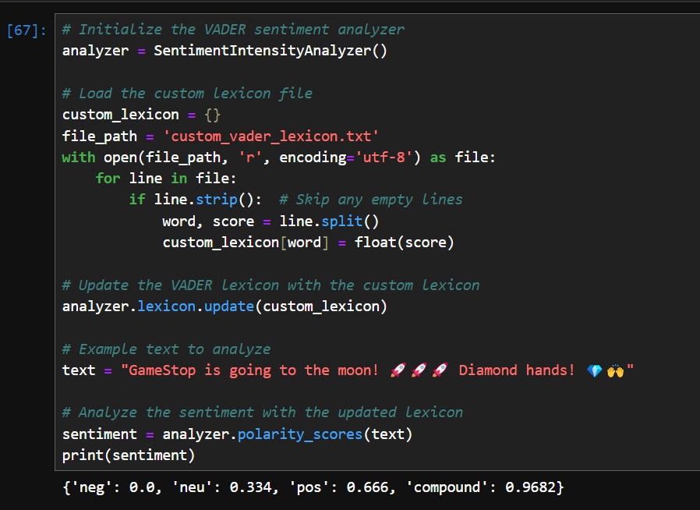
Generative AI
Custom Lexicon
The Final Model

Slide 13
The Final Model
Generative AI
Custom Lexicon
Notes:
The Project: The results
The final model was able to provide sentiment insights for the previous two weeks on the subreddit.
Sentiment score for a post was weighted by the number of comments and upvotes that post received.
A visual check of the sentiment data before and after incorporating the custom lexicon revealed the model did a better job of accurately measuring the sentiment of posts in relation to stocks after introducing the lexicon.
Sentiment data was grouped per stock, highlighting Nvidia, Ingersoll Rand, and Electronic Arts as the most mentioned in the last two weeks.
While NVIDIA stayed generally neutral, EA had a few days of positive sentiment between the 22nd and the 24^{th of June}
And Ingersoll Rand received a lot of negative sentiment just after the 21st of June.
The day of their annual report of employee stock plans: https://investors.irco.com/financials/sec-filings/sec-filings-details/default.aspx?FilingId=17635091

Slide 14
The Final Model
Notes:
The Project: The results
The final model was able to provide sentiment insights for the previous two weeks on the subreddit.
Sentiment score for a post was weighted by the number of comments and upvotes that post received.
A visual check of the sentiment data before and after incorporating the custom lexicon revealed the model did a better job of accurately measuring the sentiment of posts in relation to stocks after introducing the lexicon.
Sentiment data was grouped per stock, highlighting Nvidia, Ingersoll Rand, and Electronic Arts as the most mentioned in the last two weeks.
While NVIDIA stayed generally neutral, EA had a few days of positive sentiment between the 22nd and the 24^{th of June}
And Ingersoll Rand received a lot of negative sentiment just after the 21st of June.
The day of their annual report of employee stock plans: https://investors.irco.com/financials/sec-filings/sec-filings-details/default.aspx?FilingId=17635091

Slide 15

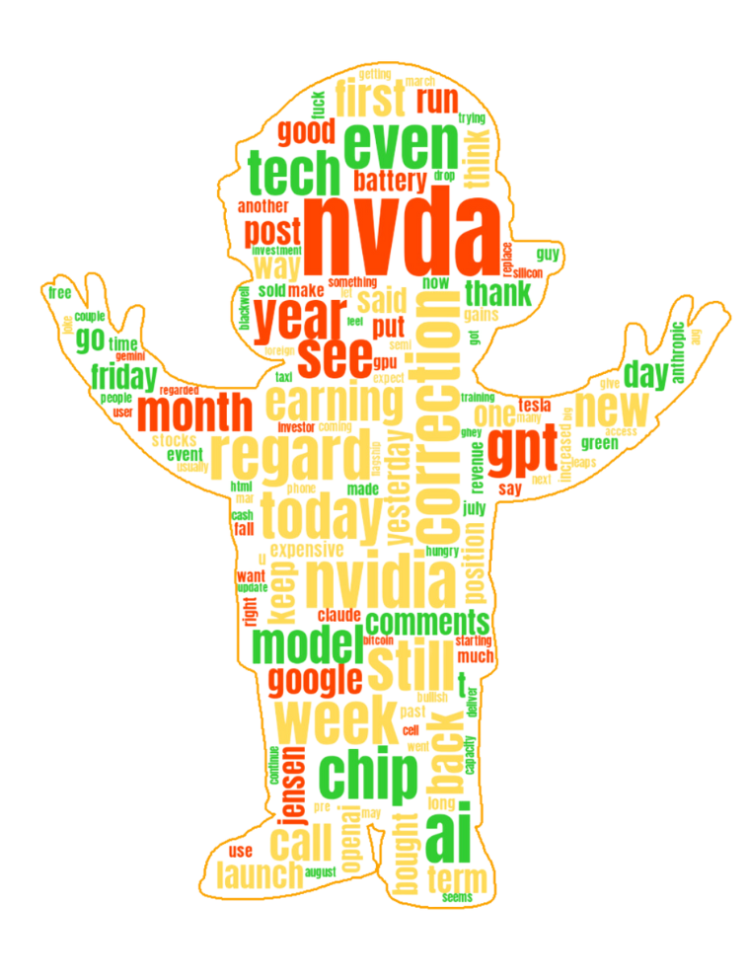
The Final Model
Insufficient Data
Unmeasured
model
Notes:
The Project: The results
The final model was able to provide sentiment insights for the previous two weeks on the subreddit.
Sentiment score for a post was weighted by the number of comments and upvotes that post received.
A visual check of the sentiment data before and after incorporating the custom lexicon revealed the model did a better job of accurately measuring the sentiment of posts in relation to stocks after introducing the lexicon.
Sentiment data was grouped per stock, highlighting Nvidia, Ingersoll Rand, and Electronic Arts as the most mentioned in the last two weeks.
While NVIDIA stayed generally neutral, EA had a few days of positive sentiment between the 22nd and the 24^{th of June}
And Ingersoll Rand received a lot of negative sentiment just after the 21st of June.
The day of their annual report of employee stock plans: https://investors.irco.com/financials/sec-filings/sec-filings-details/default.aspx?FilingId=17635091

Slide 16

The Final Model
Insufficient Data
Unmeasured
model
Notes:
Ultimately, the utility of this project at present is limited.
With insufficient labelled data for training, the model has not been fit or tested for accuracy.
Due to a lack of time, correlation between the sentiment measured and returns in the stock market was not explored.
Improvements made by the custom lexicon are anecdotal and unquantified.
Comment data could not be included due to reddit API throttling and sentiment was weighted solely by upvotes.
Likely omitting important measurements for calculating sentiment.
With more time, a large amount of WSB labelled data would be used to train the model and test it with a number of metrics to assess robustness.
This would also enable improvements by the custom lexicon to be quantified.
Furthermore, provided sufficient correlations are found, the model could be used to make predictions on stock performance based on historical data.
Overall, there is evidence that monitoring social media for financial forecasting is worthwhile, however, this model requires many improvements before it is of any use.
But I did make a cool word cloud.

